Slide 1
Weekly Poor PDP Case Review
Jul 27 - Aug 9, 2026

Slide 2
Weekly Poor PDP Case Review
Overview | Jul 27 - Aug 9, 2026
Metric | Value
Total Poor Case in last 2 weeks | 75
Total Types of Product | 17
Total Case related to Log Team (%) | 58 (77.3%)
Total Case not related to Log Team (%) | 17 (22.7%)

Slide 3
Weekly Poor PDP Case Review
Problems Pattern | Jul 27 - Aug 9, 2026
Problem | Cases | Products | %
包裝問題 | 29 | 10 | 50.0%
其他 | 10 | 9 | 17.2%
原箱問題 | 7 | 4 | 12.1%
罐裝問題 | 7 | 2 | 12.1%
溫度問題 | 5 | 3 | 8.6%

Slide 4
Weekly Poor PDP Case Review
Comparison of Performance by Districts | Jul 27 - Aug 9, 2026
Rank | District | Cases | Rep. Product (ID + Name) | % of Log Team
1 | ETK | 13 | H0888001_S_P10020854 | [原箱] 屈臣氏蒸餾水 800ml X 24 (新舊包裝隨機... | 22.4%
2 | WTX | 9 | H0888001_S_P10136268 | [原箱] 玉泉梳打水330ml x 8罐裝 x 3 | 15.5%
3 | NT-ST | 8 | H0888001_S_10147857 | 鈣思寶高鈣高蛋白質豆奶250毫升 x 6 (新舊包裝隨機發送)... | 13.8%
4 | NT-TM | 8 | H0888001_S_P10020921 | [原箱] 梳打水 330ml x 24 (新舊包裝隨機發送)... | 13.8%
5 | ETH | 5 | H0888001_S_10007451E | 有機無調整豆乳 (六盒非原箱)(新舊包裝隨機發貨) | 8.6%
6 | ETX | 4 | H0888001_S_P10016911 | 頂上茉莉香米 #金象#金象牌#香米#米#煮食#煮飯#煲仔飯#... | 6.9%
7 | NT-TSM | 3 | H0888001_S_P10020854 | [原箱] 屈臣氏蒸餾水 800ml X 24 (新舊包裝隨機... | 5.2%
8 | NT-TW | 3 | H0888001_S_P10021200 | [原箱] 罐裝可口可樂汽水 (新舊包裝隨機發送) | 5.2%
9 | WTH | 3 | H0888001_S_P10136268 | [原箱] 玉泉梳打水330ml x 8罐裝 x 3 | 5.2%
10 | WTK | 2 | H0888001_S_10011866 | 廣島蠔 (2L) #北吉 #Ocean Point (急凍-1... | 3.4%
Total Log Team Cases: 58 | Sum%: 100.0%

Slide 5
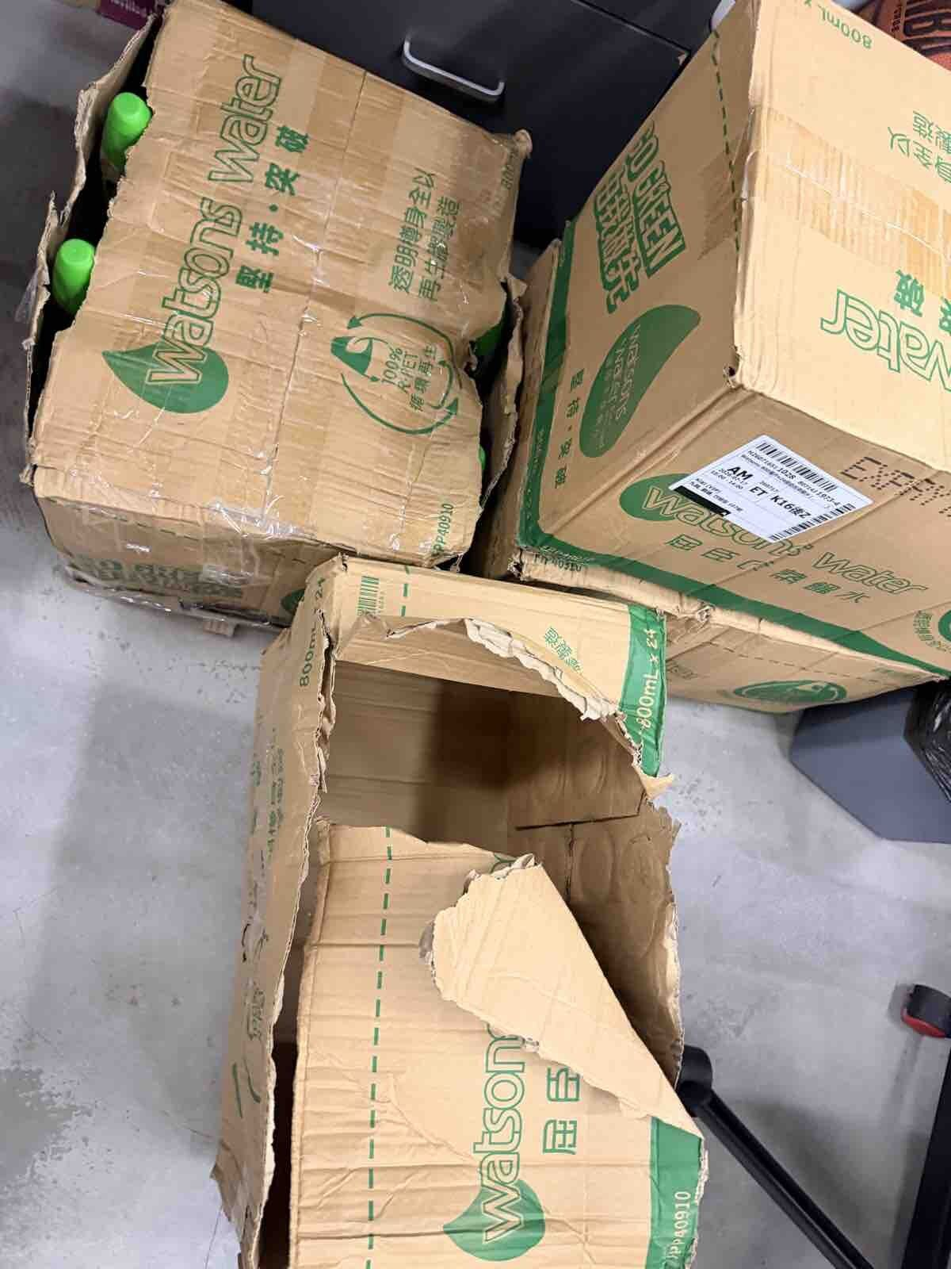
Weekly Poor PDP Case Review
Case Review - 包裝問題 (29 cases in window)
Product ID: H0888001_S_P10020854 | [原箱] 屈臣氏蒸餾水 800ml X 24 (新舊包裝隨機發送)
District: ETK
Shipping Warehouse: 將軍澳倉
Pickpack Warehouse: Warehouse貨
Order: H260716511028 | Waybill: 8071431973-1
Checking Result: 產品本身包裝箱用再做紙製成, 非常軟及易破爛
有成三四箱啲紙箱爛晒
1/2

Slide 6
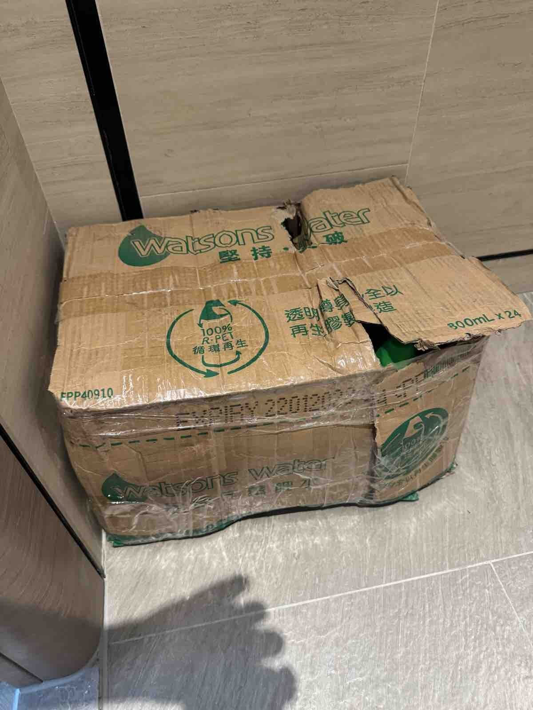
Weekly Poor PDP Case Review
Case Review - 包裝問題 (29 cases in window)
Product ID: H0888001_S_P10020854 | [原箱] 屈臣氏蒸餾水 800ml X 24 (新舊包裝隨機發送)
District: NT-TM
Shipping Warehouse: 屯門倉
Pickpack Warehouse: Warehouse貨
Order: H260807509935 | Waybill: 8111095944-1
Checking Result: 翻查貨品入倉相片已見到貨品入倉時包裝已經有爛
已經唔係第一次，今次忍唔住影低相，水冇問題，但紙箱爛到咁，箱水又咁重，搬遠少少拎落自己車都有難度。
保持包裝完整有咁難嗎？越做越差。
2/2

Slide 7
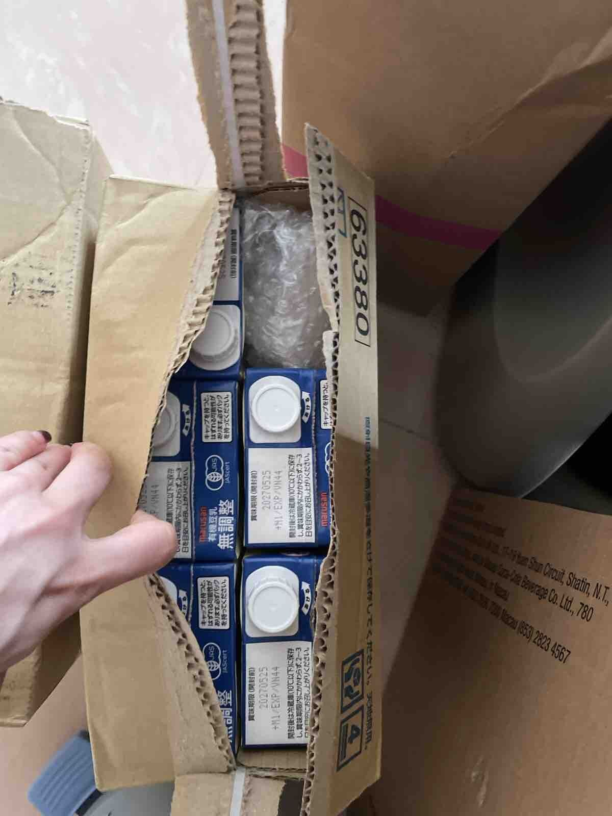
Weekly Poor PDP Case Review
Case Review - 其他 (10 cases in window)
Product ID: H0888001_S_10007451E | 有機無調整豆乳 (六盒非原箱)(新舊包裝隨機發貨)
District: WTX
Shipping Warehouse: 青衣倉
Pickpack Warehouse: Warehouse貨
Order: H260724508543 | Waybill: 8085385500-1
Checking Result: 貨倉出小貨問題
6盒變5盒，1盒變咗泡泡紙……

Slide 8
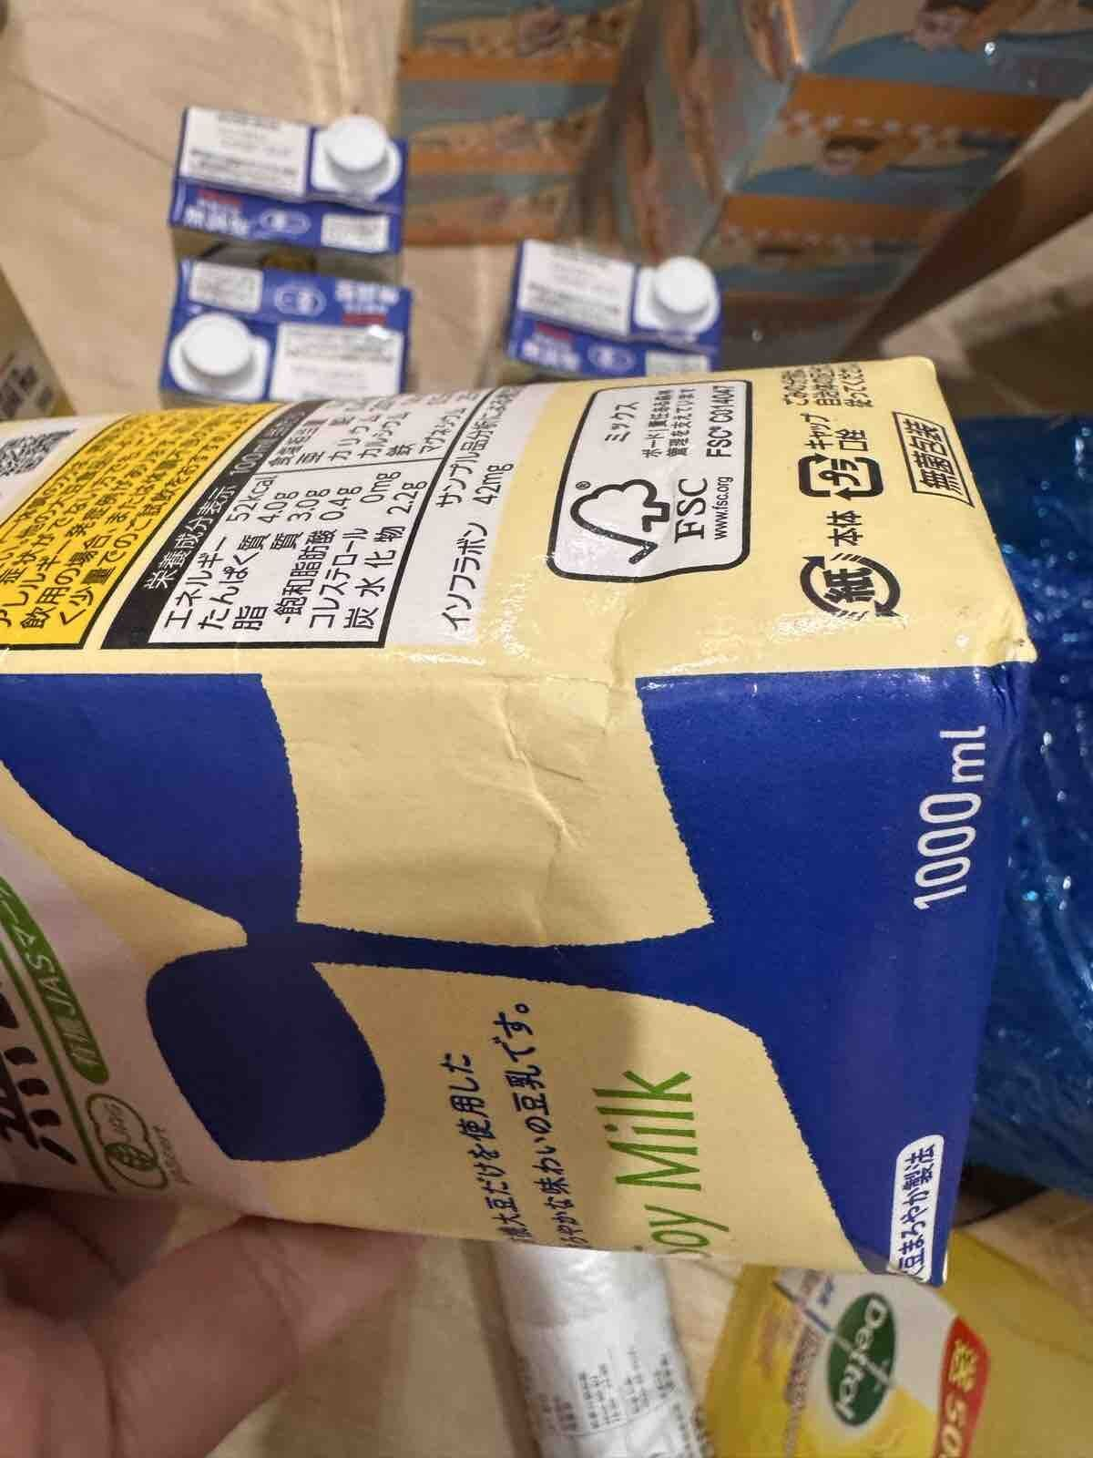
Weekly Poor PDP Case Review
Case Review - 原箱問題 (7 cases in window)
Product ID: H0888001_S_10007451E | 有機無調整豆乳 (六盒非原箱)(新舊包裝隨機發貨)
District: ETK
Shipping Warehouse: 將軍澳倉
Pickpack Warehouse: Warehouse貨
Order: H260726518477 | Waybill: 8089863649-1
Checking Result: SSI出貨問題 , 欠缺保護, 非物流問題
喺度同啲客玩字虱，唔寫原箱就亂咁送，完全冇一盒係完整，袋都無個，錢就識收。
下便全部評論寫檢討根本冇檢討過。即係除咗threads@RickyWong，根本冇人理。
1/2

Slide 9
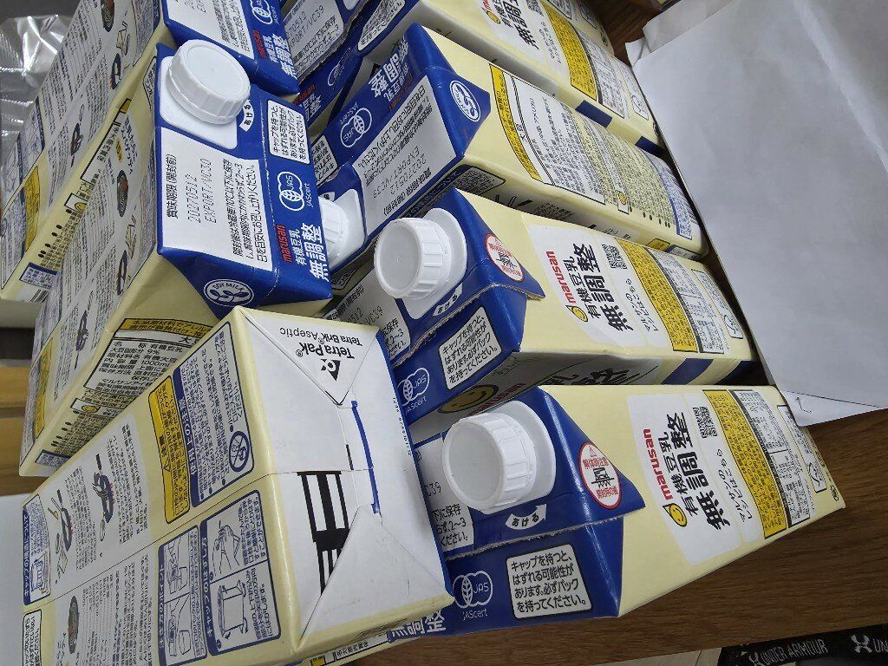
Weekly Poor PDP Case Review
Case Review - 原箱問題 (7 cases in window)
Product ID: H0888001_S_10007451E | 有機無調整豆乳 (六盒非原箱)(新舊包裝隨機發貨)
District: NT-ST
Shipping Warehouse: 屯門倉
Pickpack Warehouse: Warehouse貨
Order: H260726513046 | Waybill: 8089624286-1
Checking Result: SSI出貨問題 , 非物流問題
我訂了三箱，結果送來18盒散裝豆乳！跟HKTVmall投訴，他們沒有正面處理我的問題，非常失望！ 除非你們不介意收散裝貨， 不建議 跟這個商家訂購！！
2/2

Slide 10
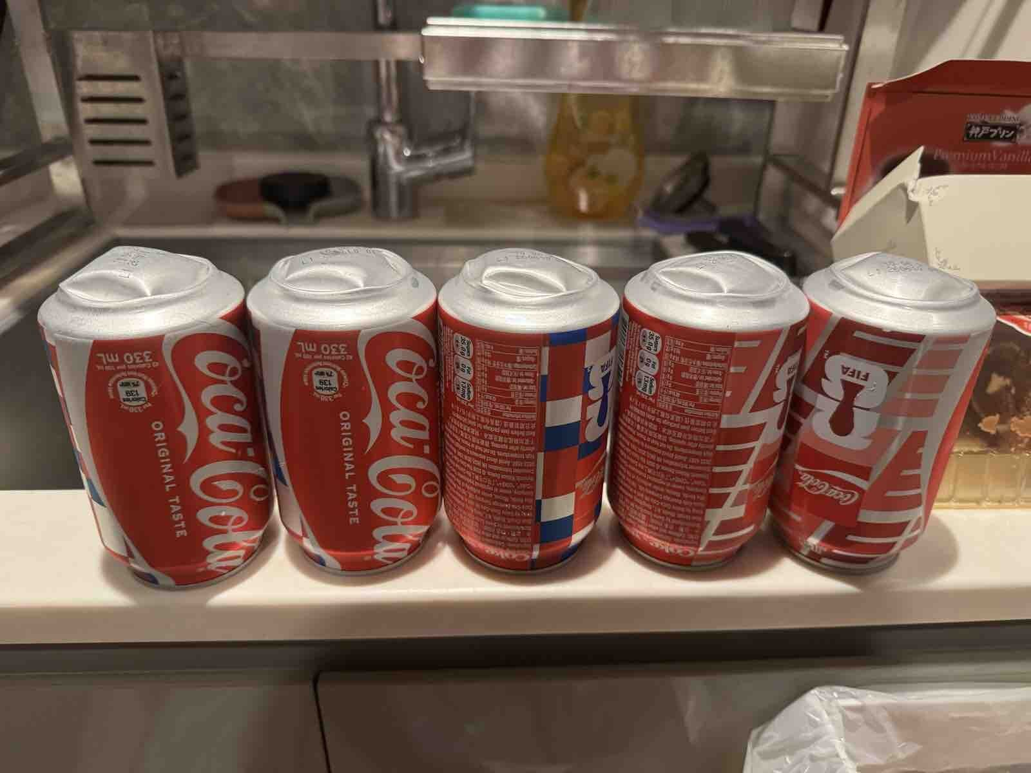
Weekly Poor PDP Case Review
Case Review - 罐裝問題 (7 cases in window)
Product ID: H0888001_S_P10021200 | [原箱] 罐裝可口可樂汽水 (新舊包裝隨機發送)
District: ETK
Shipping Warehouse: 將軍澳倉
Pickpack Warehouse: Warehouse貨
Order: H260630503000 | Waybill: 8041121017-3
Checking Result: 凸罐問題, 主要為儲存狀況引起, 非人為導致
之前已經遇過一次，以為咁岩
今次一排8罐有5罐都係突起
太過份啦
1/2

Slide 11
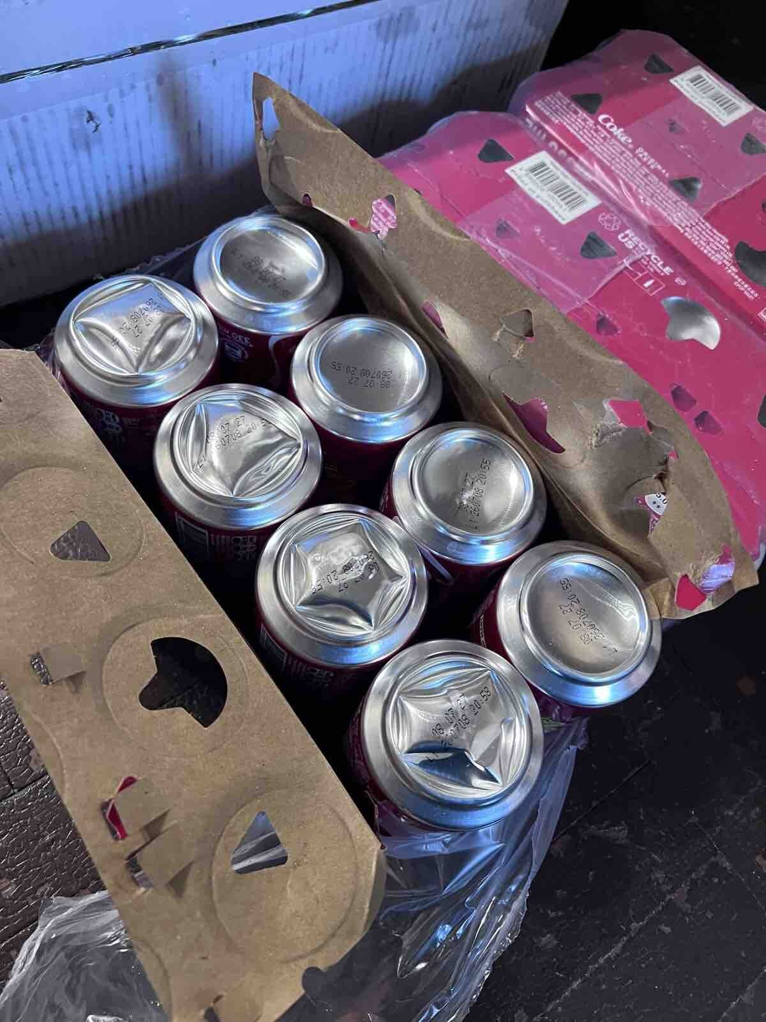
Weekly Poor PDP Case Review
Case Review - 罐裝問題 (7 cases in window)
Product ID: H0888001_S_P10021200 | [原箱] 罐裝可口可樂汽水 (新舊包裝隨機發送)
District: WTH
Shipping Warehouse: 青衣倉
Pickpack Warehouse: Merchant貨
Order: H260731539990 | Waybill: 8099329190-2
Checking Result: 過往不少以上情況都是在倉存高溫下引起
罐有明顯擠壓痕跡有凹凸表面，雖然只有四罐，但係應該整盆可樂都會有撞過，味道都會有唔同，好不幸被我遇上😭😭
2/2

Slide 12
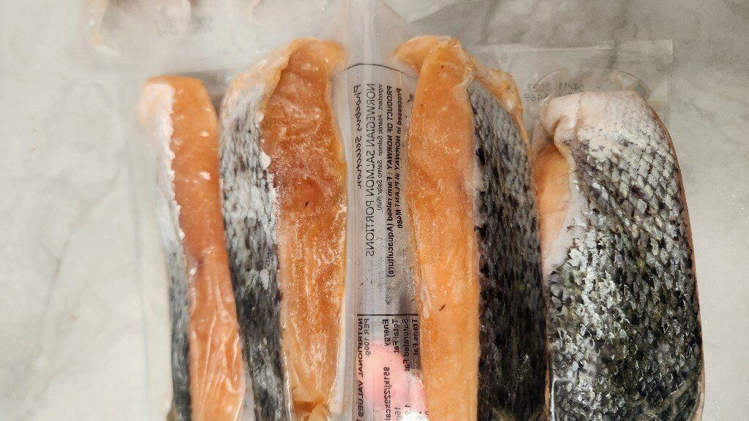
Weekly Poor PDP Case Review
Case Review - 溫度問題 (5 cases in window)
Product ID: H0888001_S_10137502A | 挪威三文魚柳 (連皮)(4件裝 x 2包) (急凍) #海鮮#氣炸#香煎 #未去除魚鱗以免魚油流失, 及以免魚肉容易散及乾
District: ETX
Shipping Warehouse: 青衣倉
Pickpack Warehouse: Warehouse貨
Order: H260731512412 | Waybill: 8098191058-1
Checking Result: 見到圖片三文魚仍然冰硬
十分差，送來時候已有少溶雪，加上品質明顯有問題， 要求退回，但是還未有回覆，有冇搞錯，麻煩hktv mall盡快跟進

